Slide 1
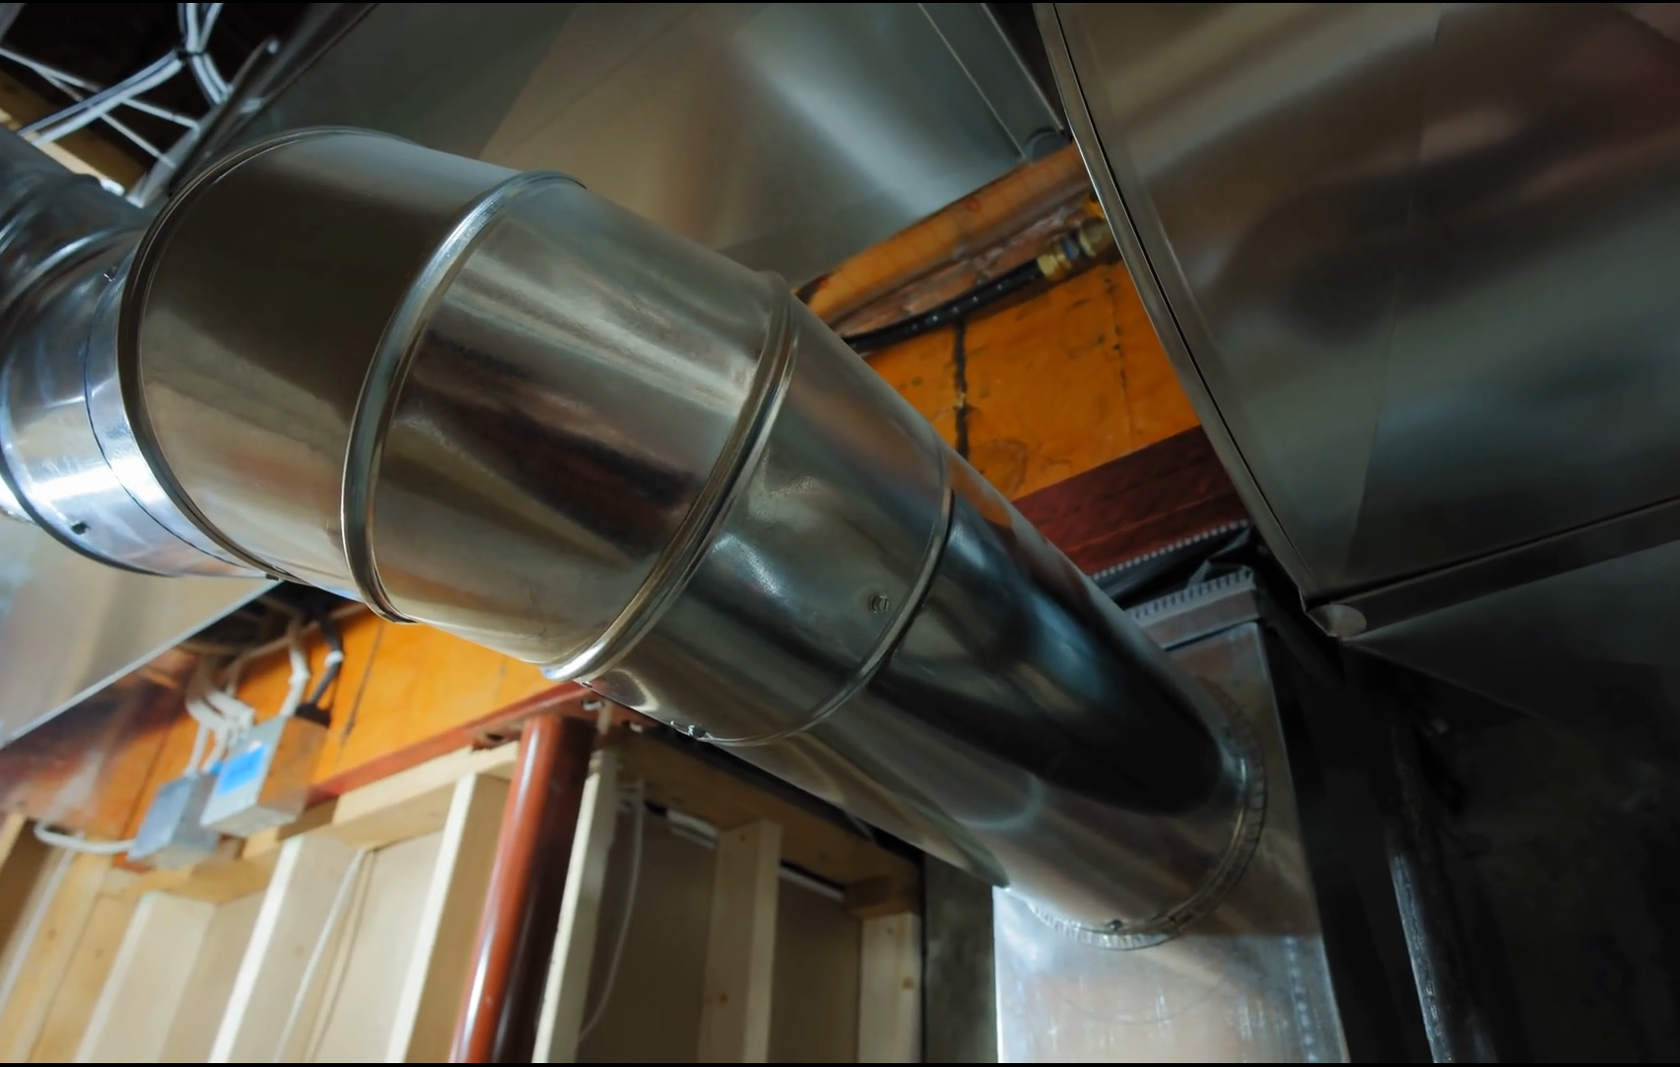
Ducts, Mufflers, and Silencers
Silencers and flow
Tyler Dare

Slide 2
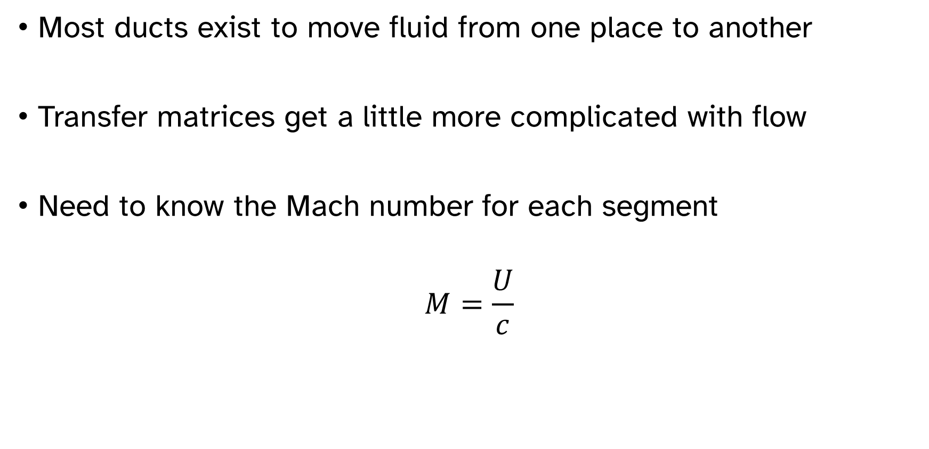
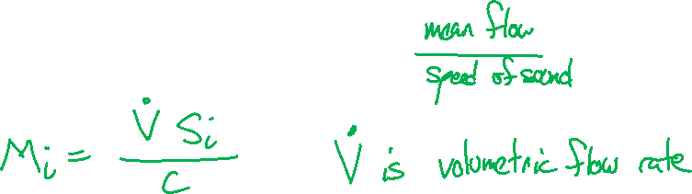
Flow affects duct acoustics
Most ducts exist to move fluid from one place to another
Transfer matrices get a little more complicated with flow
Need to know the Mach number for each segment
$$M=\frac{U}{c}$$

Slide 3
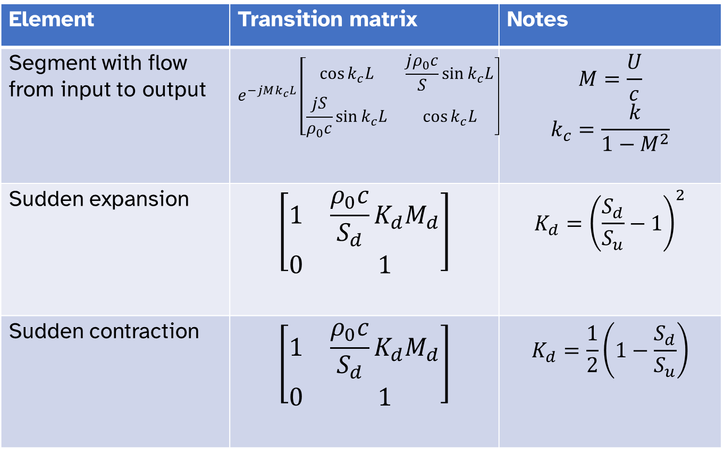
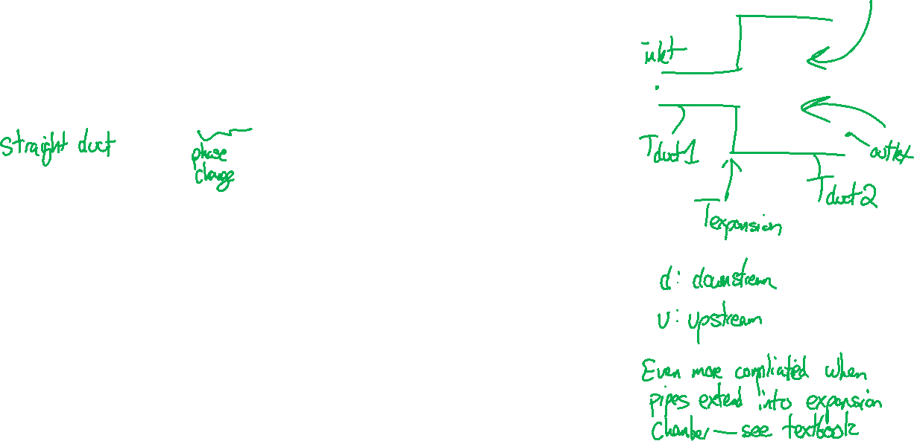
Effect of flow in duct segment
Element | Transition matrix | Notes
Segment with flow from input to output | $$e^{−jMk_{c}L}\left[\begin{matrix}\cos{k_{c}L} & \frac{jρ_{0}c}{S}\sin{k_{c}L} \\ \frac{jS}{ρ_{0}c}\sin{k_{c}L} & \cos{k_{c}L}\end{matrix}\right]$$ | $$M=\frac{U}{c}$$ $$k_{c}=\frac{k}{1−M^{2}}$$
Sudden expansion | $$\left[\begin{matrix}1 & \frac{ρ_{0}c}{S_{d}}K_{d}M_{d} \\ 0 & 1\end{matrix}\right]$$ | $$K_{d}={\left(\frac{S_{d}}{S_{u}}−1\right)}^{2}$$
Sudden contraction | $$\left[\begin{matrix}1 & \frac{ρ_{0}c}{S_{d}}K_{d}M_{d} \\ 0 & 1\end{matrix}\right]$$ | $$K_{d}=\frac{1}{2}\left(1−\frac{S_{d}}{S_{u}}\right)$$

Slide 4
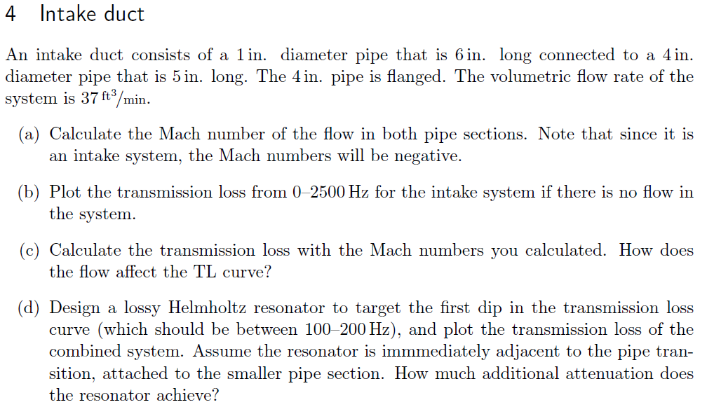
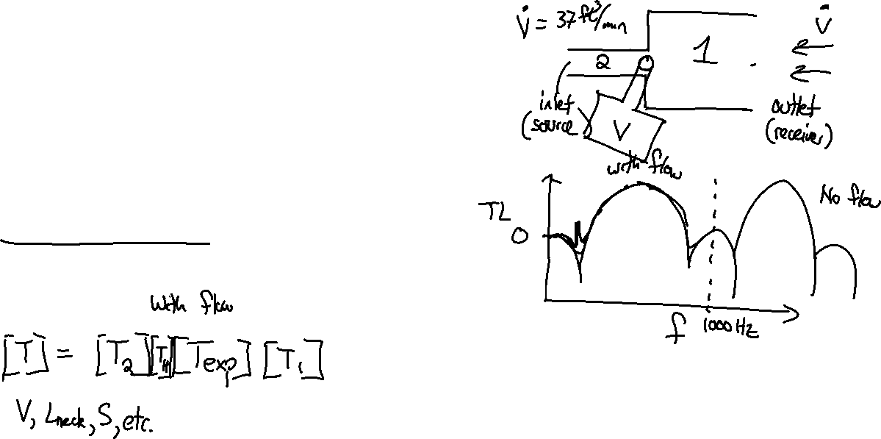

Slide 5
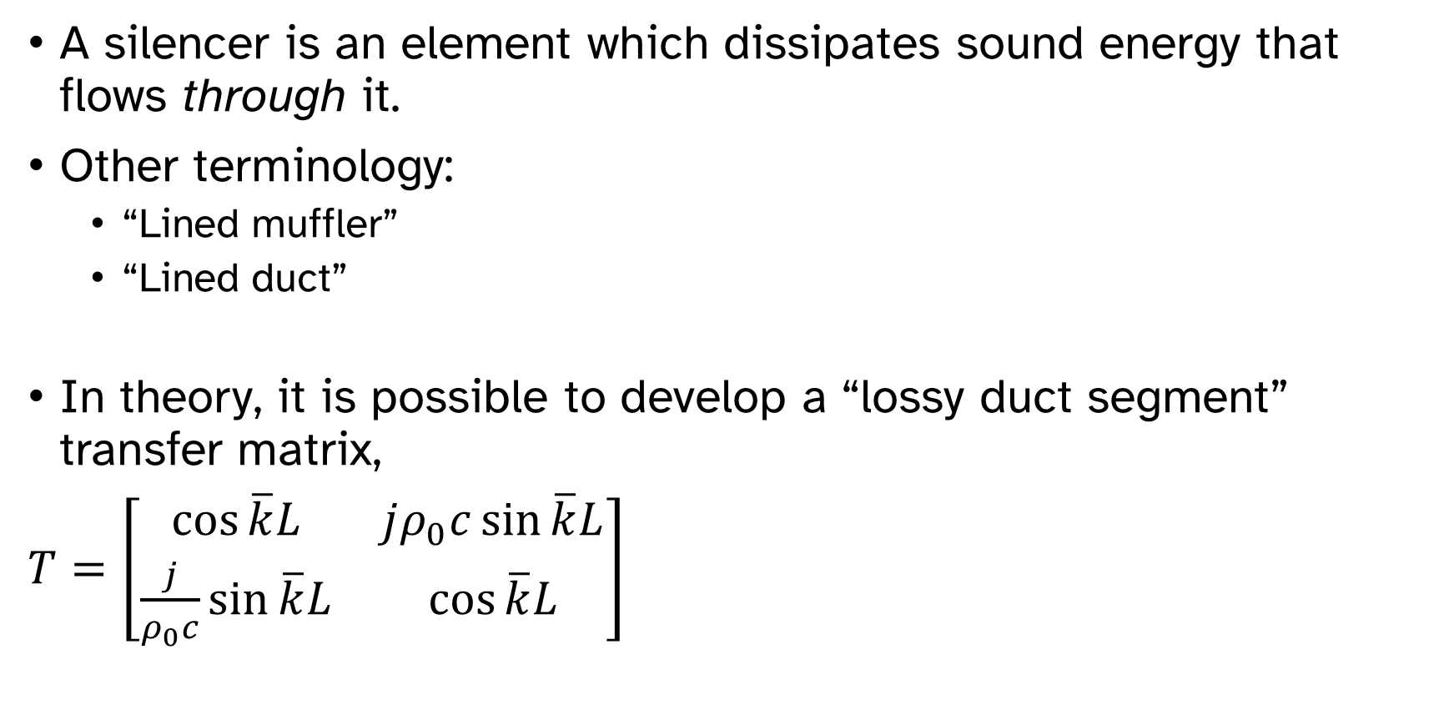
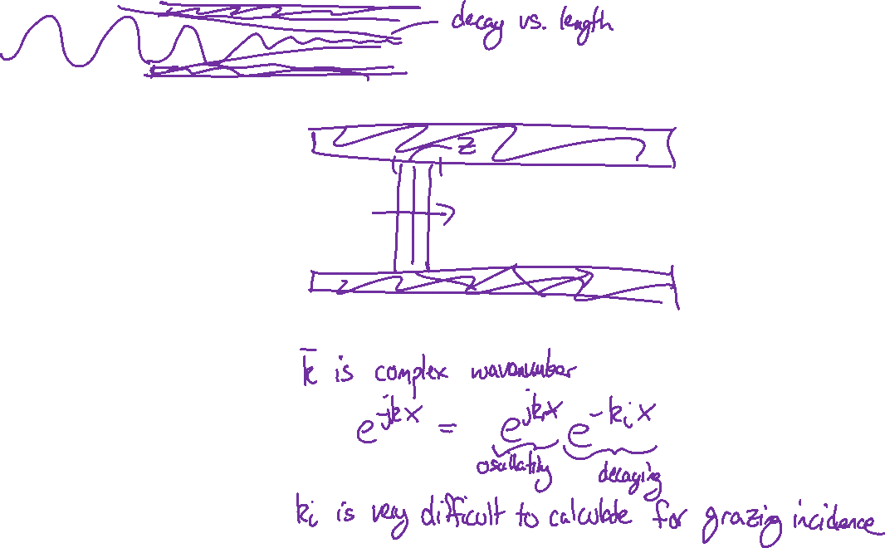
Silencers
A silencer is an element which dissipates sound energy that flows through it.
Other terminology:
“Lined muffler”
“Lined duct”
In theory, it is possible to develop a “lossy duct segment” transfer matrix,
$T=\left[\begin{matrix}\cos{\overline{k}L} & jρ_{0}c\sin{\overline{k}L} \\ \frac{j}{ρ_{0}c}\sin{\overline{k}L} & \cos{\overline{k}L}\end{matrix}\right]$

Slide 6
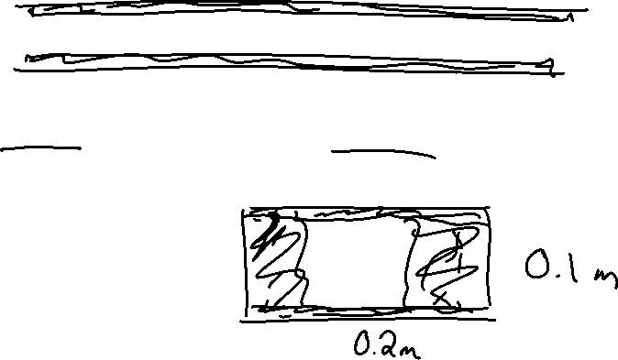
Silencer example problem
A long duct that is 0.2 m by 0.1 m is to have an acoustic liner installed. The goal is to achieve 15 dB of attenuation at 100 Hz.
What material should be used?
How much of the duct needs to be lined?
How thick does the liner need to be?

Slide 7
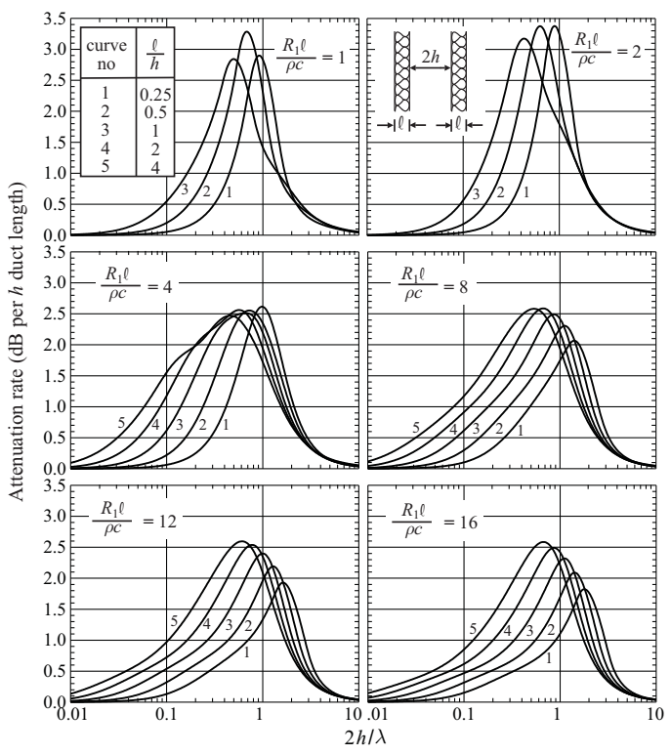
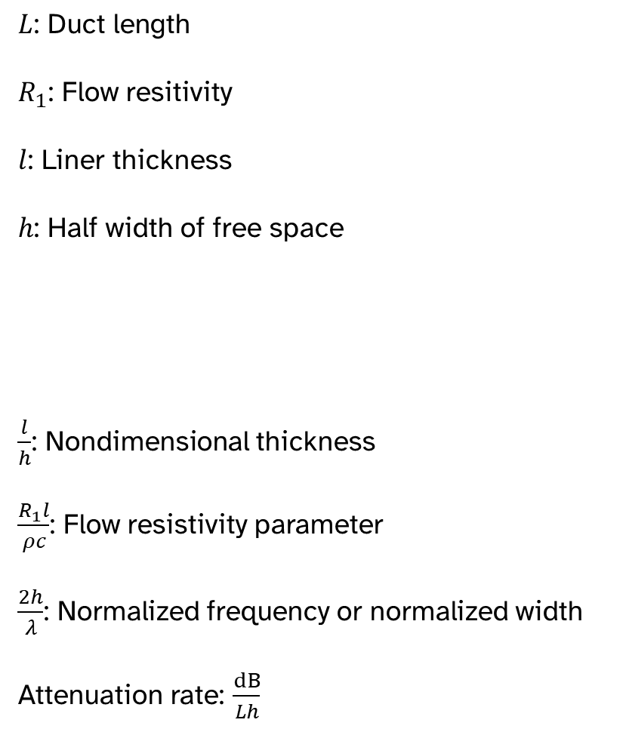
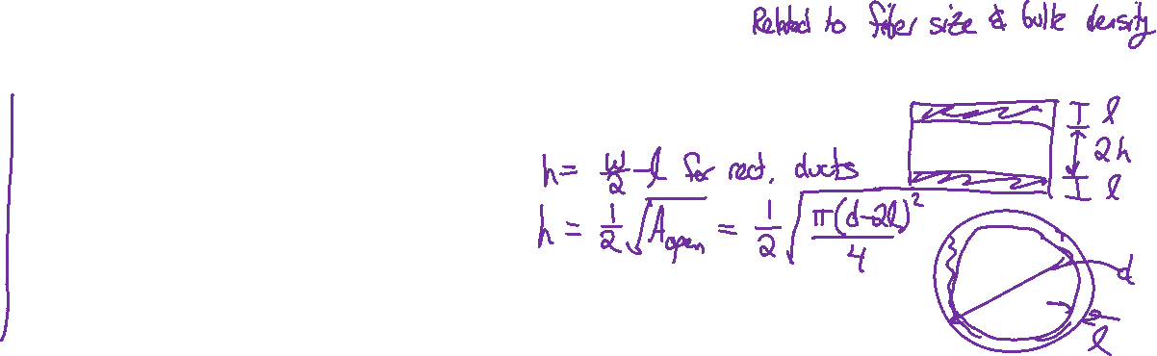
Attenuation rate plots
$L$: Duct length
$R_{1}$: Flow resitivity
$l$: Liner thickness
$h$: Half width of free space
$\frac{l}{h}$: Nondimensional thickness
$\frac{R_{1}l}{ρc}$: Flow resistivity parameter
$\frac{2h}{λ}$: Normalized frequency or normalized width
Attenuation rate: $\frac{dB}{Lh}$

Slide 8
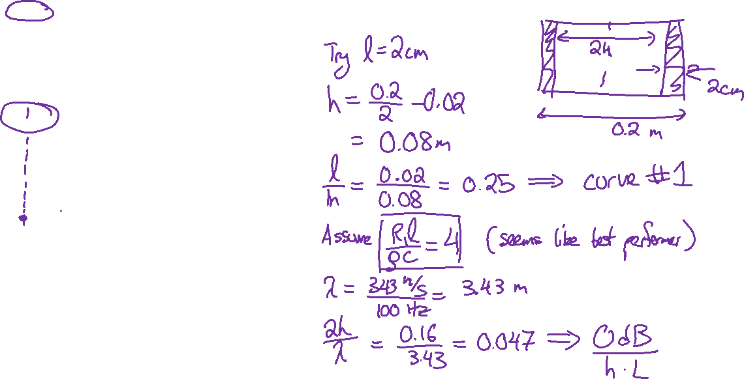
Liner design example
0.2 m by 0.1 m is to have an acoustic liner installed. The goal is to achieve 15 dB of attenuation at 100 Hz.

Slide 9
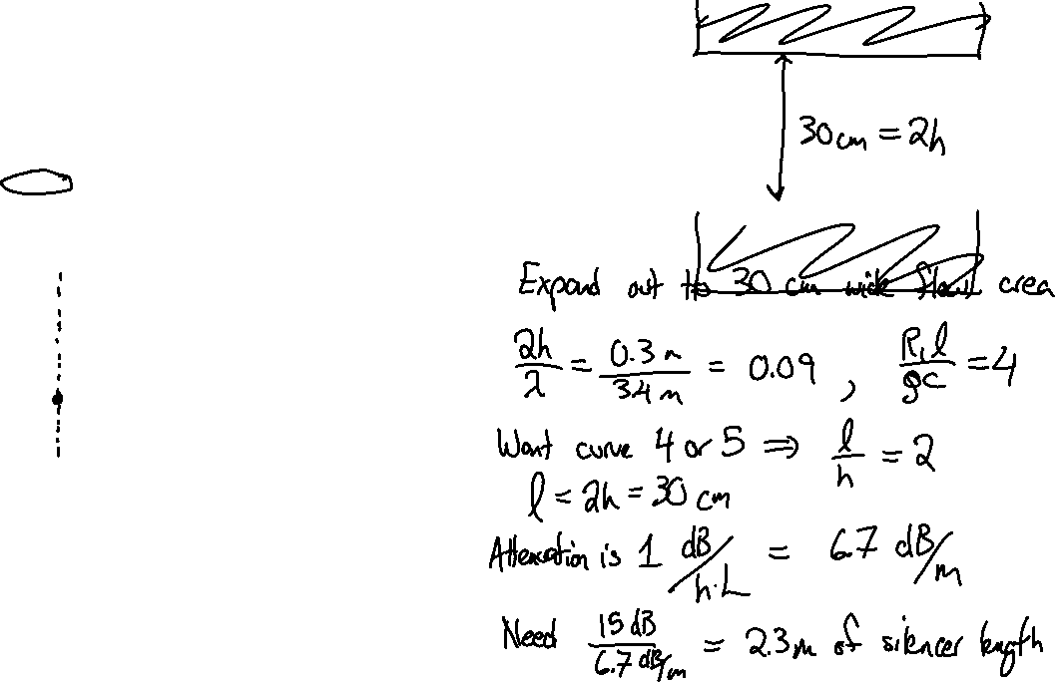
Liner design example

Slide 10
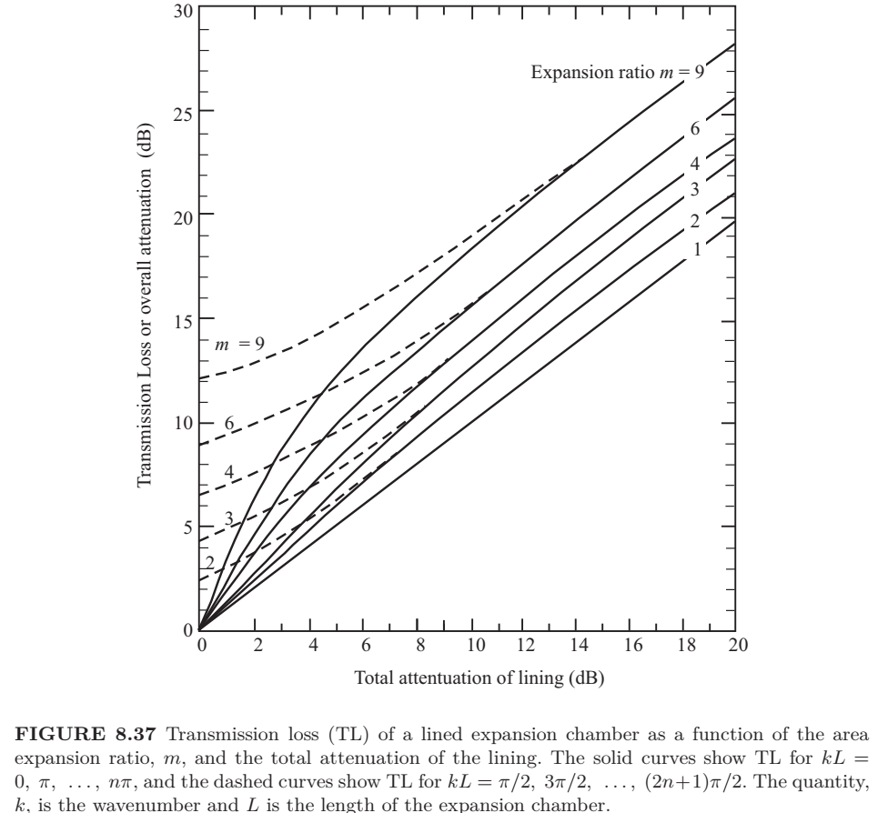
Expansion chamber gives extra attenuation

Slide 11
